Slide 1
ASD

Slide 2
Aims of session
What ASDs are.
The behaviours linked with ASD.
The impact on a student’s learning, behaviour and social inclusion.
Interventions and strategies that can be used to support pupils with ASD.
Cultural perspective of ASD.
Other organisations and support
To help you to follow up the session directly in your own practice.

Slide 3
ASD questionnaire
 | True | False
A withdrawal into fantasy life
A mental illness
A developmental disorder – a biological or organic defect in the functioning of the brain
A middle class disorder
Associated with epilepsy
More likely in boys than in girls
Due to parental rejection i.e. cold ‘refrigerator’ parents

Slide 4
 | True | False
Genetically linked
Associated with learning difficulties
A result of emotional deprivation or stress
Associated with genius
Associated with organic causes
Associated with unusual responses to sensory stimuli
Curable

Slide 5

Triad of Impairments
(Wing & Gould)
Impairments of social interaction
Impairments of communication
Impairments of imagination and flexible thinking
These are associated with a repetitive pattern of behaviour
Notes:
DSM criteria:
Qualitative abnormalities in reciprocal social interaction:
Inadequate use of non-verbal behaviours to regulate social interaction. Failure to develop age appropriate peer relationships. Lack of social or emotional reciprocity. Little sharing of enjoyment, achievement or interests with others.
Qualitative abnormalities in communication:
Delayed or absent development of language. Difficulty initiating or sustaining conversation. Repetitive, unusual or stereotyped use of language. Lack of age appropriate pretend or socially imitative play.
Restricted, repetitive behaviours, activities or interests:
Interests that are extremely narrow, intense or unusual. Unreasonable insistence on sameness and following specific routines or rituals. Stereotyped and repetitive motor mannerisms. Pre-occupation with parts of objects.
I’ve put this rainbow down here, because the term includes autism and related medical diagnoses (such as Asperger’s Syndrome, Rett’s Disorder, Pervasive Developmental Disorder – not otherwise specified). The range of difficulties children with ASD can present – really does vary, and I can’t stress that enough. You need to take each child individually.
Some children do not fit the full description of autism, but nevertheless have significant difficulties within the areas of the triad.
You’ve also got pupils with Aspergers -

Slide 6
Variability of behaviour in ASD
Social Interaction
Aloof-passive-odd-overpolite
Communication
Mute-echolalic-literal-pedantic
Restricted behaviour
Repetition-obsession-deep expertise
(Frith 2002)
Notes:
To highlight the ‘spectrum’ of ASD.
No one child with ASD is alike.

Slide 7
Theories of underlying difficulties
Executive functioning deficit
Theory of Mind
Central coherence
Male-female brain continuum

Slide 8

Executive functioning deficits
Working memory can be very specific
Difficulties in shifting sets and ‘switching’ attention from one task to another.
Difficulties in inhibiting a response.
Inflexibility on abstract reasoning tasks.
Notes:
Working memory – analogy of using a ‘cup’ instead of a ‘bucket’ to retrieve from the ‘memory well’.
Inflexible problem-solving strategies – ‘train track’ analogy – can’t divert ‘off road’. Coping with unexpected changes. Can be poor at generalisation and organisation, Need cues and prompts to structure learning.
It may come across as them Not respecting boundaries, staring, asking personal questions, repetitive questions. Lacking empathy and being insensitive or oblivious of needs of others. It may also manifest as an Inability to wait or Concept of ‘finish’ can be hard to accept.
But it can also mean that they are very good at rote tasks.
Don’t learn from mistakes and repeat same processes –assume processes are okay.
Poor comprehension of instructions
Difficulties retaining verbal information
Misunderstanding due to problems recognising non-verbal cues, humour, hints, ironies and sarcasm
Seeking help appropriately
Initiating a response to an open-ended task
Engaging in rituals that irritate others or disrupt activities
Sensory reactions – noise, light, smell, tactile, temperature etc..
Can you identify others ?

Slide 9
Implications of EF deficit
Strategies?
Creating a calm working environment
Direct pupil’s attention on an individual level
Organising and planning, prioritising and time keeping.
Self reflection and self-monitoring – may need to externalise thoughts.
Notes:
So what does this mean for you as Learning Support Assistants? How can you put your knowledge of this into practice? Before I go into some recommendations – based on what we have just talked about, about them finding it difficult to be flexible in their thinking processes and attending to one thing or switching this attention– what strategies do you think might help? Brainstorm on flip chart
1) Important as some may have hypersensitivities – and with their difficulties with focus – they can get easily distracted by noises and other people. So a calm environment is important. Pupils with ASD often feel very comfortable when working at workstations, for this reason – high sides, so can attend to their work.
2) They may need to be told that the instructions apply to them – which is where you come in.
3) Break down the task into clearly identifiable steps, develop a hierarchy of subgoals – Which is very much what children with ADHD might need. Can use checklists. They may have difficulty with stopping and starting so need to be given set time frames- use a visual timetable or organisation of their working time in class.
Many pupil’s with ASD in mainstream respond well to paired work, such as paired writing, where the ‘tutor’ (a peer) is asking them questions which helps them to organise ideas about their writing, and vice versa. This also gives them an opportunity to have social interactions but in an academic setting which they can understand.
I was working with one pupil who found it very difficult to understand why we learnt to write in prose in one lesson and then had to write in tables in the other. Needed visual timetable to prepare him for that change and explanations of why
4)

Slide 10

Theory of mind
Notes:
Smarties activity – need two volunteers. Scarf.

Slide 11
In the Smarties tube there are pencils…..
What is X (who had scarf round their head) going to think is in the Smarties tube?
What is X going to feel when the Smarties tube is opened?
Child or YP with ASD would think that the other person knows that there are pencils in there and does not think that they would be surprised.
Difficulty with putting themselves in ‘the other person’s
shoes’.

Slide 12
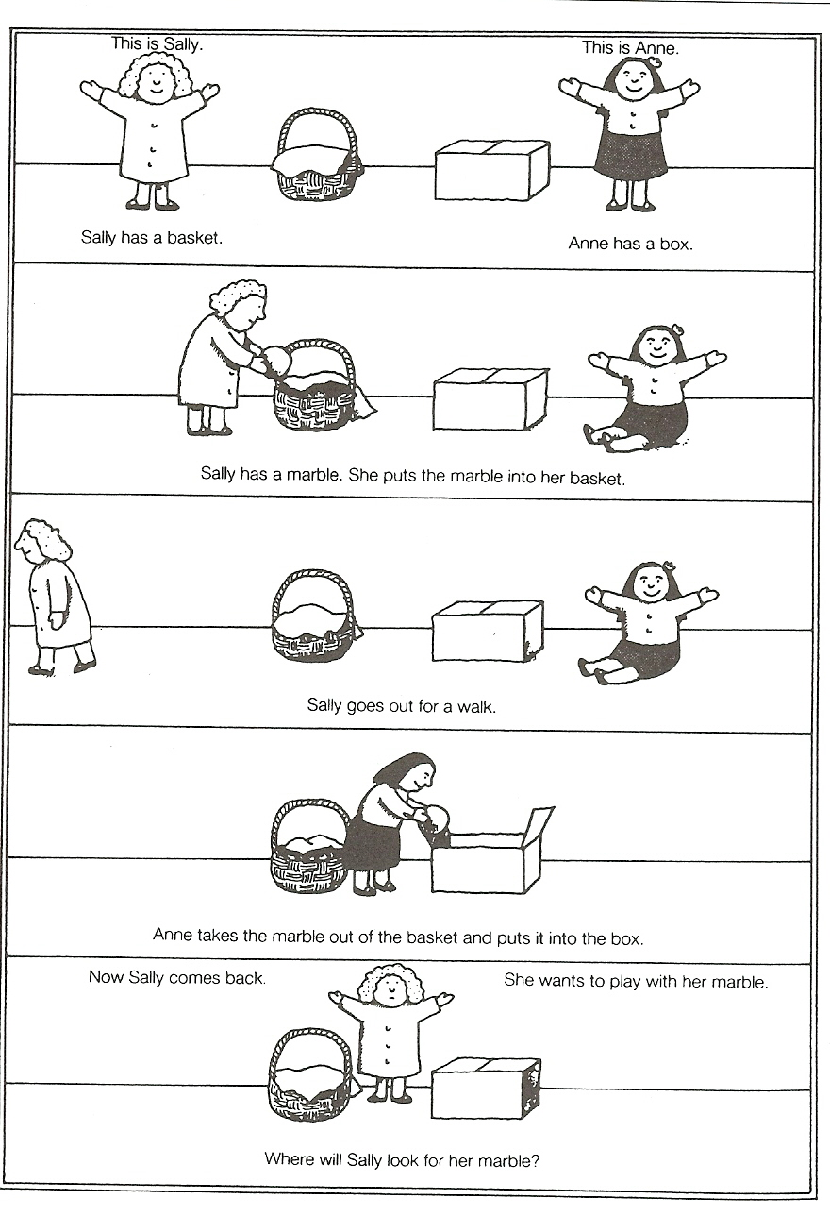
Notes:
This is another example of another similar thing for your reference. It’s called the Sally Ann task.

Slide 13
Theory of mind deficit
Difficulty in predicting others behaviour
Difficulty in reading the intentions of others and understanding the motives behind their behaviour
Difficulty in explaining their own behaviour
Difficulty in understanding emotions, leading to lack of empathy
Difficulty in taking into account what others know or can be expected to know
Inability to read and react to the listeners level of interest in what is being said
Inability to predict what others might think of your actions
Inability to deceive or understand deception
Difficulties in sharing attention, leading to idiosyncratic reference
Lack of understanding of social interaction, leading to difficulties in turn-taking, poor topic maintenance in conversation and inappropriate use of eye-contact.
Difficulty in understanding pretend and differentiating fact from fiction
Notes:
This is the impact of having a Theory of Mind deficit.

Slide 14
Implications of ToM deficit
Strategies?
Teach basic social skills.
Draw their attention to the use of non-verbal cues in social interaction to convey attitudes and meaning
Make the child aware of himself as a problem solver, to promote self reflection and recognition of self experience.
Be explicit when giving instructions.
Be aware that a pupil’s use of language may not reflect their understanding.
Notes:
So what does this mean for you as Learning Support Assistants? How can you put your knowledge of this into practice. Before I go into some recommendations – based on what we have just talked about, about them finding it difficult to understanding other people’s thoughts and the social difficulties they have as a result of that – what strategies do you think might help? Brainstorm on flip chart
1) e.g. listening, not interrupting, pausing to allow others a turn, sharing equipment, waiting in lines, working in small groups.
But be aware that some children find social skills extremely demanding and stressful task – there may not be much space left for dealing with academic tasks.
2) Non-verbal cues e.g. gesture, facial expression, eye direction, or proximity
3) Peer monitoring - this may mean helping him to check what other people’s feeling, thoughts beliefs and attitudes are.
4) Don’t assume that context will make it clear
5) Beware of assuming that pupil’s language level equals their communication level – need to check the pupil’s understanding

Slide 15
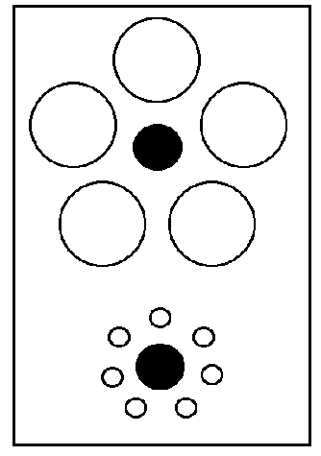
Central coherence
Notes:
What do you see? (bring tape measure)
ASD see parts over wholes
Others suggested that the ToM deficit that we have just talked about, does not fully explain why children with ASD behave the way they do. It did not explain everything.
However it does mean that they are very good at hidden figures e.g. Embedded Figures Test e.g. a house in a larger drawing.

Slide 16
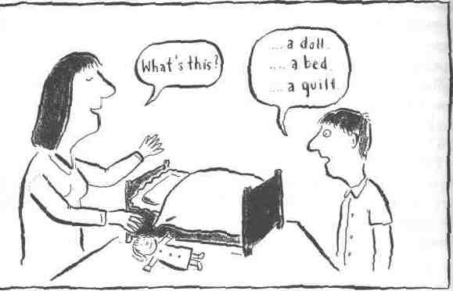
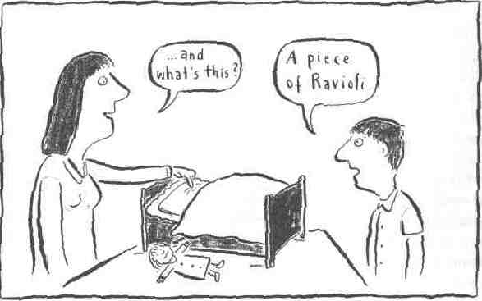
Son – Sun
Meet – Meat
Sew – So
Know - No
Notes:
Child not joking, nor visually impaired. Did look like ravioli if taken out of context. Subjects with ASD free from contextual constraints.
Imbalance in integration of information at different levels. Normally we draw together diverse information to construct higher level meaning in context.
Heard one story where a five year old, was asked by a psychologist to “take your book out”. He got up and left the room with it.
This applies to language too:
We remember the gist of a story but not the fine details – general impression of the whole, and from this we construct the probable detail. ASD - Takes stock of the situation detail by detail, not talking the WHOLE gestalt into account. This can be translated as pedanticness or having poor comprehension or sticking to one particular detail and not being able to let go.
WE CAN understand contextually appropriate sense of ambiguous words (synonyms) – son-sun, meet/meat, sew-so. know/no.
Frith predicts subjects with ASD good at tasks where attn to local information – piecemeal processing- advantageous, but poor at tasks requiring recognition of global meaning.

Slide 17
Implications of central coherence deficit
Strategies?
Make beginning and end points of tasks clear
Avoid ambiguity, use visual cues to highlight meaning.
Make the connections with previous skills or knowledge explicit.
Draw pupil’s attention to cause, effect, motives and plot.
Clear classroom rules
Notes:
So bearing in mind what we have just talked about – can anyone think of strategies ? We know that they are Visual learners, often see the ‘parts’ not the whole, focus on trivial information for example, what does that mean that you might do?
They may not be attending to what is the obvious focus of attention to you or the teacher. So they will need clear prompting and structure. May get carried away with details. May need the obvious pointing out. May also need a model or a picture of the end goal so that the pupil knows what is expected.
2)
3) Difficulty with seieng connections – may show great aptitude in one area of knowledge but be be unable to generalise them. For example, one pupil may be really good at maths, and can calculate 3 figure multiplications in his head, but when a teacher give them the same problem but presented differently – they might get anxious and say that they can’t do it. So be aware of changes that may have occurred – it may also help to ask them why they are upset – they can probably offer their perspective which will enable you to see with an Autistic Lens.
4) You may need to do this using a sequence of picture cards for example.
5) Pupils with ASD may show a lack of compliance – and sometimes the obvious needs pointing out to them and why they need to be taught how to notice the demands in others (perhaps need a prearranged visual cue with teachers or LSA) and why they should follow this behaviour. Being told that everyone else does it, doesn’t help. Need to be told why, and how to notice it.

Slide 18
Extreme male brain theory
(Baron-Cohen, 2002)
Continuum of male-female brain.
Systematisers vs Empathisers
ASD = extreme male brain.
Sex ratio:
  Autism spectrum: 4:1 (male:female)
  Asperger Syndrome: 9:1
Notes:
Empathizing (E)
– identify a person’s thoughts and feelings
– respond to these with an appropriate emotion
Systemizing (S)
– analyse or build a system
– mechanical, natural, abstract, collectible
Most male and females contain elements of both. Some more than others.
When tested on empathy – typically developing males and females are very close to each other, although men are slight lower than females (a score of 41 and 47 respectively), but people with ASD have the lowest by all (20). Similarly they come out very high on systematising.

Slide 19



Label vs. needs
As professionals in education the challenge is to:
  Recognise patterns of strengths and weaknesses
  Build upon strengths
  Generate effective intervention strategies
Notes:
I’m put the symbols at the bottom to remind us: to put strategies into action and to make sure that we monitor and evaluate this. No one strategy fits all. Need to adapt for different children

Slide 20
Strengths
It is easy to become focused on difficulties but typical
strengths may include:-
Wide vocabulary
Special Skills
Good Visuo-Spatial Skills & Strong LT Memory
Ability to work with systems / patterns –precision to detail
Love of routine
Extensive knowledge of specialist areas
Immunity to peer pressure
Being honest
Sense of humour – albeit idiosyncratic
Insight and motivation to progress

Slide 21
Perspectives
Concept of ‘Neurotypicals’
Autistic pride movement:
“I am not a ‘person with autism’. I am an autistic person…. Saying
person with autism suggests something is bad – so bad that it isn’t
even consistent with being a person. Nobody objects to using
adjectives to refer to characteristics of a person that are considered
positive or neutral”.
Jim Sinclair (1998)
Notes:
There is the idea that they just have a different way of thinking, and who are we to say that is the wrong way of thinking just because it does not fit into society?
There is an autistic pride movement – highlighting that the notion of difference needs to shed its shameful connotations.

Slide 22
Philosophy of interventions/strategies
Different approaches may have very different underlying assumptions about ASD. In UK, we are quite eclectic and draw on many types of interventions.
Embracing the nature of ASD or changing it?
  Learning styles and strengths v deficits.
  Child centred versus adult directed.
Autism specific or more generic approaches / inclusion focus.
Family focused or child focused.
Changing the environment rather than changing the child.
Ideal approaches are individualised (e.g. one size fits all).
Notes:
We aware that when you go on the internet, or in the newspapers – there are loads of interventions out there, there are some really helpful resources, but there are also some that have not been tested thoroughly- like the use of brain gym or motor-coordination programmes which claim that they help children with ASD – there may be evidence, but it is not strong enough for us to endorse it at the moment. (There was one in Good Housekeeping recently). So please try and cast a critical eye.
As I was saying in the previous slide, some children with ASD are rather proud of the way they are and the way they think. Who are we to say that it should be changed? Perhaps we should be adapting the way we teach to suit them? So bear that in mind when you are working with an ASD pupil. This might be a poor analogy but we wouldn’t expect a deaf person to listen harder, so why should we ask a person with ASD to cope with change? Obviously – there does have to a balance on both sides, but is about making reasonable adjustments and expectations.
Take the child cue with how open they want to be about their ASD, but don’t be embarrassed to talk about it, because that will only pass on the message to them that it is something they should be embarrassed about it. But bear in mind that every child is different.
Children and YP with Autism are still people with autism in their own right. ASD is a part of them, but does not have to explain everything that they do. So you may find that the strategies that you apply in working with other children also work for them. Equally any behaviour difficulties don’t necessarily have to be because they have ASD but because they are Joe or David, just like any other child.
However - in relation to a case I heard recently – If you did decide to set up a reward system - there are somethings that they find rewarding that we may not. Like doing their favourite activity – I heard that one boy (very young and in a special school) particularly liked stroking the the caretaker’s bald head. So they agreed this with the caretaker and set up 5 minutes of stroking his head, as long as he had achieved his goals for that day.
Make sure there is good home-school communication, and be creative about this. It’s a team responsibility, so don’t leave it up to the next senior person. Maybe there are some behaviour issues, and you might want to ask the parent if they are experiencing something similar or what strategies they use at home. Some schools make use of a daily diary to support this.

Slide 23
Understanding is key
Identify problem
Why might this be happening ?– use autism lens (triad areas)
What strategies may overcome problem ?
Do we need to adapt environment, teach new skills and/or alternative behaviours, use modification techniques, increase staff awareness ?
Notes:
Use SEN Heads of Year, Krysia, teachers, ASD teachers (Jayne?) and EPs. All opinions are valuable. You and the teachers are the ones that spend the most time with these children.
National Autism Plan for Children (2003)
The NAPC: Plan for the identification, assessment and diagnosis and access to early interventions for pre-school and primary school aged children with autistic spectrum disorders (ASD). But many elements are still applicable to secondary school.
Produced by National Initiative for Autism: Screening and assessment NIASA
Published by National Autistic Society for NIASA in collaboration with range of professional bodies

Slide 24
General pointers for management
Avoid ‘overload’
  Use structure, frameworks and visual supports
  Use clear and concise language
Make adaptations to the environment
Promote flexibility and awareness amongst staff and pupils
Build on and respect strengths and interests
Negotiation
Notes:
Language - Don’t use baby language or try to simplify things because they you are inhibiting their learning, but do minimise unnecessary language or going off on a tangent. Try to be concrete and say what is necessary.
By awareness: Respect differences / facilitate understanding of diagnosis

Slide 25
General pointers continued….
Give sensitive feedback - tell individuals ‘what to do’, rather than focus on inappropriate actions.
Seek opinions / personal perceptions of difficulties if possible.
Respect the ‘individual’ – ‘one size does not fit all’
Notes:
You all have experience of working with ASD – you might even be sharing similar problems – one might have a strategy to offer that you could try out. It’s important that you have the opportunity to share knowledge and support.
That may mean setting aside structured time maybe half hour a week, to bring issues to other LSAs. Problem solve together.
Use the teachers – if you are aware of what is going on before hand – you can plan ahead and pre-empt issues, prepare materials. Raise these to the teacher. All teachers should be teachers of SEN.

Slide 26
The TEACCH Approach
Physical structure
The schedule
  Visual timetable using pictures, icons or photographs of the child in different classes
Work systems
  How much work will I have to do?
  What work will I have to do?
  When will I have finished?
  What happens when I have finished?
Visual Clarity
  Tasks are presented visually
Notes:
For your reference, there are some ASD-specific interventions, which may be followed to the T in a special school where the needs are greater, but in a mainstream school – they may serve as useful pointers to research and reading that may help you with certain strategies .
Used with those that have poor communicaiton.

Slide 27

Social Stories
(Gray, 1998; Howley and Arnold, 2005)
Short personalized stories, comprising 4 recommended sentence types
Provide information difficult for people with ASD to infer: about perspectives of others, relevant social cues & expected social behaviour
Used to teach how to manage own behaviour in situations found challenging, confusing or to minimize anxiety
Can also be used to acknowledge achievement
Notes:
May be more applicable to Park High.
This provides a clear description of what will happen, where, when and with whom

Slide 28
Social Inclusion
Check:- Does the individual actually want to extend social contacts ?
Developing interests – special interest groups
Individual ‘focus’ rather than group learning?
Making it ‘safe’ – minimise anxiety
Utilise family networks
Build up ‘Circles of Support’
Social groups specific to ASD if felt useful
Volunteers and befriender schemes
Notes:
Most of our discussion today has focused on strategies to support learning. But that’s only one perspective of life in school. In reality, the school environment for someone with ASD can be very harsh and confusing.
There are different things that we can do about this and some of which may be operating here – I know that there is a lunchtime club. Is there somewhere for ASD pupils to go?
It is important to be aware of what is going on in class – if you overhear bullying comments that are directed to the pupil with ASD – it must be acted upon. If it’s like that in class, what is it like when there are no teachers there?

Slide 29

Organisations and resources
National Autistic Society: www.nas.org.uk or www.autism.org.uk
(contact in Harrow = 020 8866 2244 or nasharrow@hotmail.com)
Kids Can Achieve: www.kidscanachieve.co.uk
(contact = 020 8868 5629 or kidscanachieve@tesco.net)
Teachernet.gov.uk: www.teachernet.gov.uk/wholeschool/sen/teacherlearningassistant/asd/
Sensory and Communication Team in Harrow.
Notes:
1) NAS contains an autism awareness pack for teachers, and they are doing a big campaign on bullying at the moment – so contain lots of resources for dealing with that too.
2) Kids can Achieve is a local project – who provide parent support and local signposting/info. And run children’s groups.
3) This provides really useful practice guidelines (Guidance from the Autism Working Group)

Slide 30
Resources - books
Maine, B. (2002). Children can learn with their shoes off: Supporting Students with Asperger’s Syndrome in Mainstream Schools and Colleges.
Sainsbury, C. (2000). Martian in the Playground: Understanding the Schoolchild with Asperger's Syndrome.
Cumine, V., Leach L., and Stevenson, G. (1998). Asperger’s Syndrome: A practical guide for teachers.
Vermeulen, P. (2001). Autistic Thinking: this is the title.
Gray, C. (2000). Writing Social Stories with Carol Gray.

Slide 31
Personal Action Plan
Short-term goal:
Long-term goal:
Research I need to do:
People I need to see:
Action I need to take:

